Slide 1
AI-Driven Credit Risk, Churn, and Fraud Prediction Using Structured & Unstructured Financial Data
Goal: Build a unified ML-NLP-DL system to predict loan default, detect fraud, and prevent churn using structured and textual financial data

Slide 2
Problem Statement
❓ What is the problem or opportunity this project is investigating?
This project investigates the problem of credit card fraud detection, a high-risk domain where fraudulent transactions occur amidst millions of legitimate ones. The core challenge lies in the extreme class imbalance—fraudulent transactions make up less than 0.2% of all activity—making it difficult for traditional models to identify them without flagging too many false positives.
The project explores the opportunity to develop a robust, multi-modal fraud detection system using structured transaction data, unstructured customer feedback, and a combination of classical machine learning, deep learning, and rule-based logic.

Slide 3

Credit card fraud leads to billions in financial losses annually for financial institutions, consumers, and merchants. Inaccurate or delayed detection:
Increases financial exposure
Damages customer trust and loyalty
Results in regulatory penalties and increased insurance costs
On the other hand, false positives (flagging a legitimate transaction as fraud) can cause:
Customer dissatisfaction
Lost sales for merchants
Increased customer service costs
The current landscape of fraud detection faces several limitations:
Over-reliance on rule-based systems that cannot adapt to evolving fraud tactics
Black-box deep learning systems that are hard to explain and audit
Lack of integration between transaction patterns and customer feedback
Low recall rates on rare fraud instances due to unbalanced data
Minimal usage of text analytics for sentiment or intent cues in user complaint

Slide 4
What is the desired state?
The desired state is a modular, intelligent fraud detection pipeline that:
Accurately detects fraud with high Recall and AUC
Minimizes false alarms with acceptable Precision and Recall(In this project, recall helps ensure most or all fraudulent transactions are caught, )
Integrates transactional data with unstructured feedback (e.g., complaints, sentiment)
Provides interpretable risk scoring via agent logic and meta-risk features
Supports real-time deployment through scalable APIs and UI interfaces
What makes our project unique?
Yes, numerous research projects and industry implementations have attempted to address credit card fraud detection using:
Machine learning techniques such as logistic regression, decision trees, random forests, and XGBoost
Deep learning architectures, including MLPs and LSTMs, especially for temporal or sequential data
Imbalanced data solutions like SMOTE, ADASYN, and undersampling
Text mining and NLP in customer service domains, but rarely integrated directly with transaction-level fraud systems
While these approaches have shown success in isolation, few combine structured, unstructured, and rule-based signals into a unified framework. Our project builds upon this prior work but extends it by integrating sentiment analysis, multi-agent logic, and retrieval-augmented feedback querying into a single, end-to-end fraud detection pipeline.

Slide 5
Stake Holders and their Expectations
Stakeholder | Key Expectations
Fraud Analysts | A system that catches more fraud cases with minimal false positives. Easy-to-interpret flags and scoring logic.
Risk Executives / CROs | Strategic fraud risk reduction, explainable AI models, and regulatory alignment.
Data Scientists | Access to scalable modeling pipelines, feature-rich datasets (including sentiment and text), and performance metrics.
IT & DevOps Teams | Models that are easily deployable, stable in production, and secured via APIs or dashboards.
Customer Support | Better tools to quickly investigate flagged transactions or negative feedback.
Customers | Minimal disruption, early detection of real fraud, and confidence in their bank’s systems.
Regulators / Auditors | Transparent models, logged risk scores, and explainable triggers for each fraud flag.
FinTech Product Managers | Modern, modular architecture that allows integration into customer-facing apps for real-time fraud scoring or alerts.

Slide 6
Metric | Importance
Recall (Sensitivity) | Critical. Must capture the majority of actual fraud cases to prevent loss.
Precision | Important. Avoid flagging too many legitimate transactions (false alarms).
F1-Score | Balanced metric. Evaluates how well the model does both.
ROC-AUC | Key for ranking. Measures the model’s ability to distinguish fraud from non-fraud.

Slide 7

Dataset Overview:
The dataset contains 284807 entries (transactions) and 31 columns.
Most columns are numerical (float64 or int64).
The Time and Amount columns contain the transaction time and amount, respectively.
The target variable is Class, indicating whether a transaction is fraudulent (1) or not (0)
Class Imbalance:
The Class column value counts show a severe class imbalance.
There are 284315 non-fraudulent transactions (Class 0).
There are only 492 fraudulent transactions (Class 1).
This means only about 0.0017% of transactions are fraudulent.
This is a major challenge for training fraud detection models, as the model won't see enough examples of the rare 'fraudulent' class to learn to identify it effectively.

Slide 8
Phase 1 EDA/SMOTE (Synthetic Minority Over-sampling Technique):
Remember that massive class imbalance? (Lots of legit, very few fraud). SMOTE is a technique to help with that.
Purpose: SMOTE creates synthetic (fake but realistic) examples of the minority class (fraud) based on existing fraud examples.
Impact: Look at the y_train_bal.value_counts() output after applying SMOTE: count Class 0 227451 1 22745
dtype: int64
The number of fraud samples (Class 1) in the training data is now equal to the number of non-fraud samples (Class 0). The dataset is now balanced!
Why necessary? By giving the model more examples of fraud to learn from, SMOTE helps prevent the model from being biased towards the majority class and improves its ability to recognize the patterns of fraudulent transactions.

Slide 9
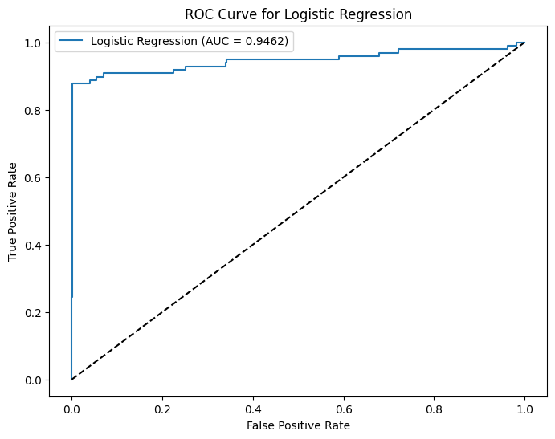
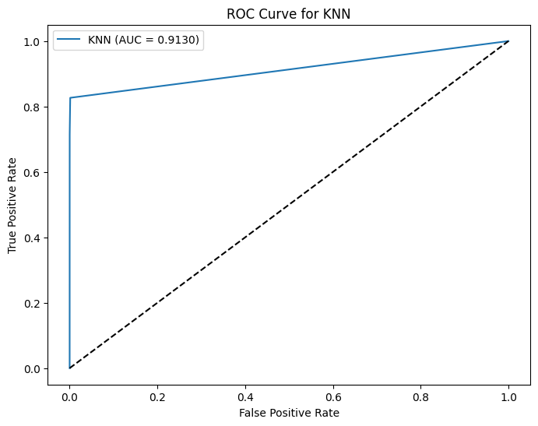
Pre Sentiment Analysis
Phase 2 Classical Machine learning models

Slide 10
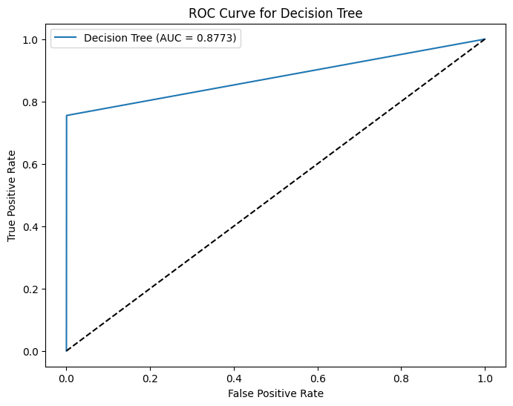
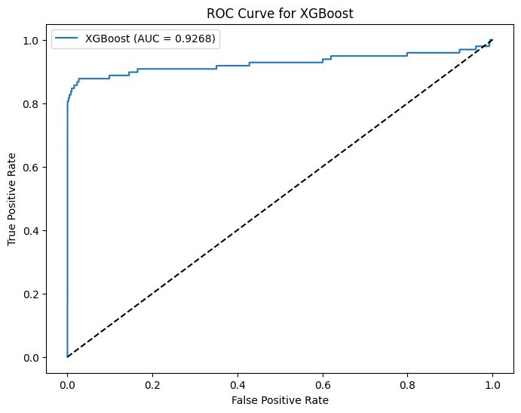
Pre Sentiment Analysis

Slide 11
CONFUSION MATRIX ALONG WITH
Model | TP | TN | FP | FN | Precision | Recall | F1-Score | ROC-AUC
Logistic Regression | 65 | 56,852 | 12 | 33 | 0.8442 | 0.6633 | 0.7429 | 0.9462
KNN | 70 | 56,858 | 6 | 28 | 0.9211 | 0.7143 | 0.8046 | 0.9130
Decision Tree | 74 | 56,840 | 24 | 24 | 0.7551 | 0.7551 | 0.7551 | 0.8773
XGBoost | 78 | 56,853 | 11 | 20 | 0.8764 | 0.7959 | 0.8342 | 0.9268
Logistic Regression: Good overall performance, decent balance between precision and recall, and a respectable AUC. A solid baseline model.
KNN: Showed very high Precision (few false alarms) but slightly lower Recall compared to XGBoost and the DL model. Good if minimizing false alarms is a top priority.
Decision Tree: Had a good balance between precision and recall (similar F1-score) but the lowest AUC, suggesting it's less effective at discriminating fraud across different thresholds compared to others.
XGBoost: Achieved a great balance (highest F1-score among classical models) with high Recall and good Precision. Also had a high AUC. A strong performer for this dataset.

Slide 12
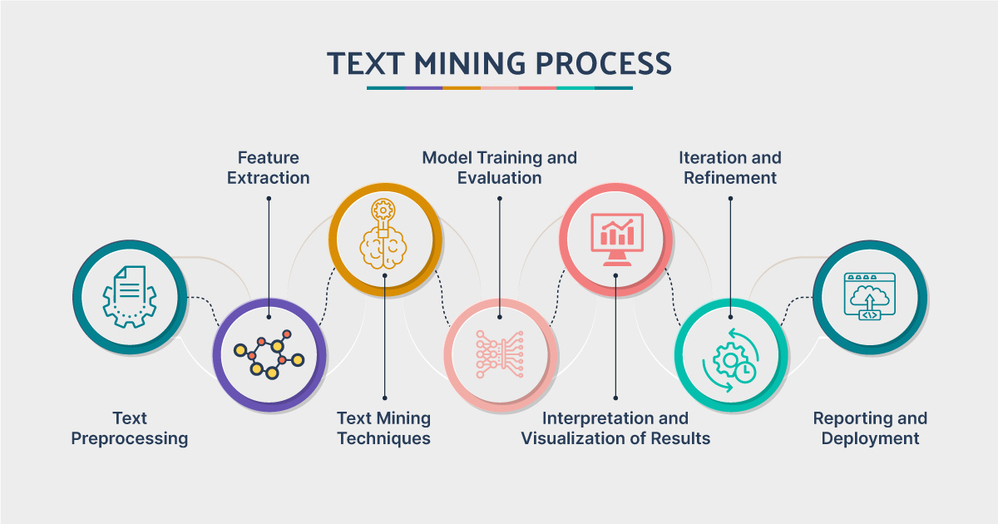
Text Mining & NLP Explanation
Step 1 :- 1.Lowercase:
Remove Punctuation:
Remove Stopwords:
Lemmatization:
Step 2: Word Cloud Insights (What Words Pop Out?)
A word cloud is a visual way to see which words appear most often in the text.
Step 3: Binary Keyword Flags (Spotting Specific Red Flags!)
Besides just looking at word counts, we wanted to specifically flag transactions if certain 'suspicious' words appeared in the text description.
Step 4: TF-IDF Vectorization (Turning Words into Numbers!)
Computers understand numbers, not words. To use the text data in our models, we need to convert it into a numerical format
Step 5: Named Entity Recognition (NER) with spaCy (Finding Important Stuff!)
NER is a technique that finds and labels 'named entities' in text, like people's names, organizations, locations, dates, or monetary values.
Phase 3

Slide 13
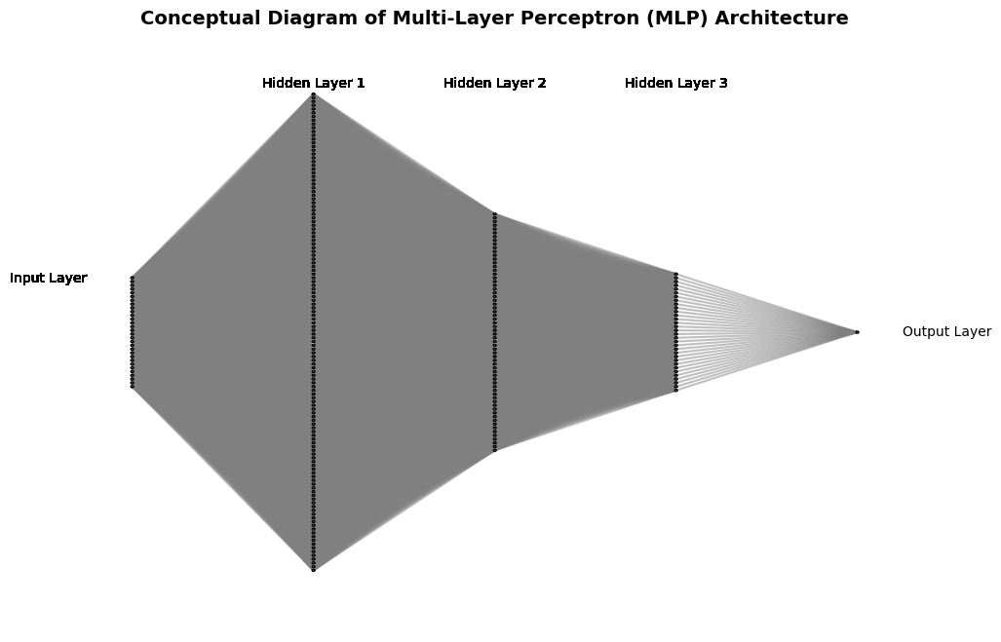
Phase 4 Deep Learning
We used a simple type of neural network called a Multi-Layer Perceptron (MLP) for deep learning
It's made up of several layers of 'neurons' that process the data step by step.
In short: Data goes through several layers of processing, getting 'filtered' and transformed at each step, before the final layer gives us a fraud probability.

Slide 14
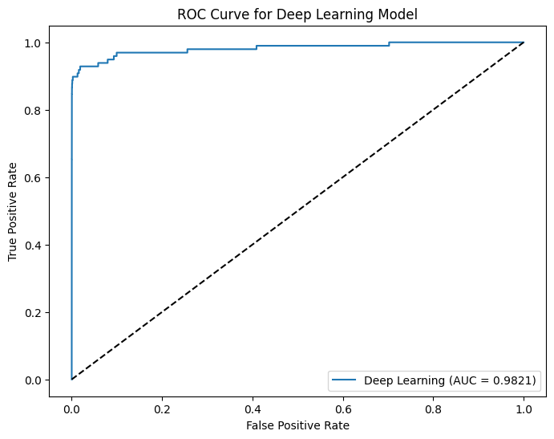
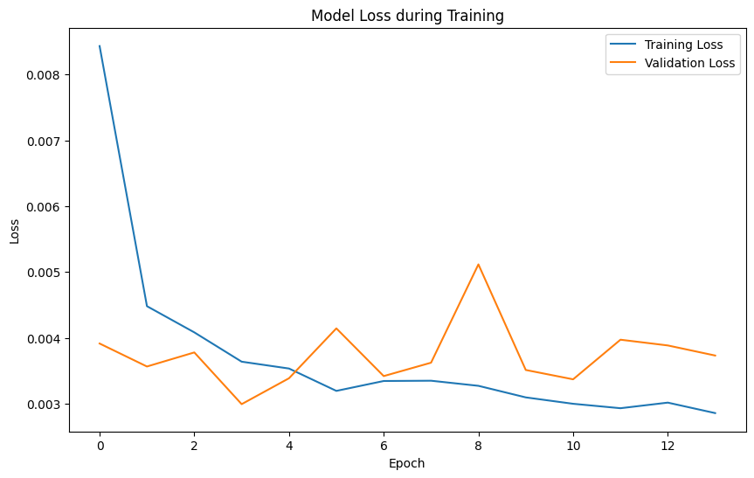

Slide 15
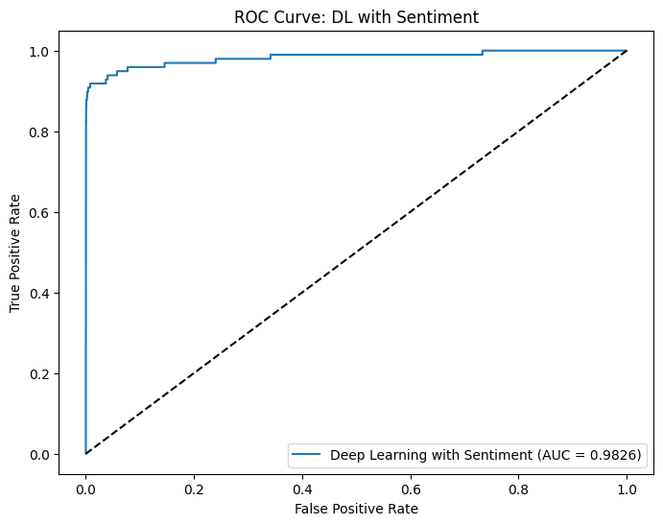
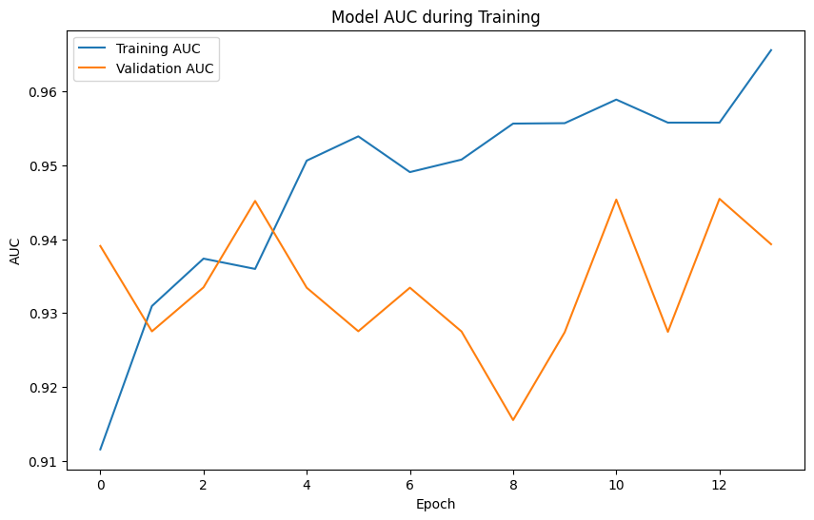

Slide 16
Model | AUC | Precision | Recall | F1-Score
Logistic Regression | 0.946 | 0.840 | 0.660 | 0.740
KNN | 0.913 | 0.920 | 0.710 | 0.800
Decision Tree | 0.877 | 0.760 | 0.760 | 0.760
XGBoost | 0.927 | 0.880 | 0.800 | 0.830
XGBoost + Sentiment | 0.937 | 0.886 | 0.796 | 0.839
Deep Learning (MLP) | 0.948 | 0.794 | 0.786 | 0.790
DL + Sentiment | 0.953 | 0.807 | 0.816 | 0.811
✅ Final Selected Model: Deep Learning MLP with Sentiment Score
The Deep Learning (MLP) model achieved the highest AUC score (~0.954).
KNN showed the highest Precision (~0.92).
XGBoost and the Deep Learning model had similar high Recall values (~0.80 and ~0.796 respectively), being best at identifying fraudulent transactions. Must capture the majority of actual fraud cases to prevent loss hence DL chosen
XGBoost had the highest F1-score (~0.83), providing a good balance between precision and recal

Slide 17
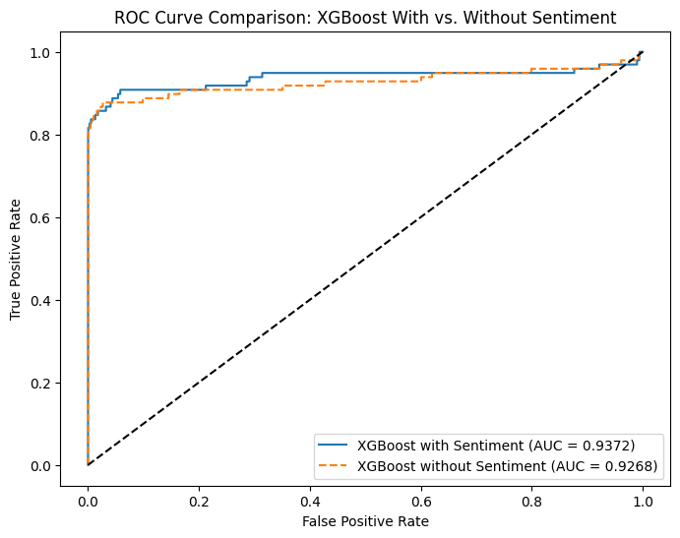
Loss and AUC Plots (Seeing the Learning Curve!)
The plots (like those in cell 54e52514 or generated from the training history) help us visualize the learning process:
Loss Plots: Show how the error (loss) decreased over training epochs for both the training data and the validation data.
We want to see the training loss go down consistently.
The validation loss should also go down initially. When the validation loss starts to flatten out or go up while the training loss is still decreasing, it's a sign of potential overfitting, which is where Early Stopping kicks in.
AUC Plots: Show how the AUC score improved over training epochs for both training and validation data.
We want to see both training and validation AUC increase, indicating the model is getting better at discriminating classes.
Similar to loss, if training AUC keeps increasing but validation AUC flattens or decreases, it suggests overfitting.
These plots confirm that the model was learning effectively, and Early Stopping helped us capture the point of optimal performance before overfitting became a significant issue.
Overall: Including the simulated sentiment score seems to have a small positive impact on the XGBoost model's ability to detect fraud, particularly in terms of Recall and overall discrimination (AUC), though with a minor trade-off in Precision.

Slide 18
Phase 5: Multi-Agent System Simulation Explanation We simulated a system where different 'AI Agents' work together to flag potentially fraudulent transactions.
The Meta-Risk Score (The Squad Leader's Decision!)
The Meta-Risk Score is like the final decision made on what all the individual agents reported.
How it worked: In our simulation, the meta_risk_score was simply the sum of the scores from all the individual agents for that transaction.
If only one agent flagged a transaction, the meta-risk score would be 1.
If all four agents flagged a transaction, the meta-risk score would be 4.
If no agents flagged it, the score was 0.
For Non-Fraudulent Transactions (Class 0): Most non-fraudulent transactions had a meta_risk_score of 0. Very few were flagged by any agents.
Average meta-risk score for non-fraud: 0.7158
Max meta-risk score for non-fraud: 3
Statistically, the distribution is heavily skewed towards 0 for legit transactions.
For Fraudulent Transactions (Class 1): Fraudulent transactions had a much wider distribution of meta_risk_scores. Many fraudulent transactions had scores greater than 0, meaning they were flagged by one or more agents. Average meta-risk score for fraud: 0.7154
Max meta-risk score for fraud: 2
Statistically, the distribution for fraud is shifted to the right compared to non-fraud, with a larger mean and maximum score. This difference in distribution is statistically significant – it shows the agent system is finding patterns that are more common in fraudulent transactions.
This helps us get a combined view of fraud risk

Slide 19
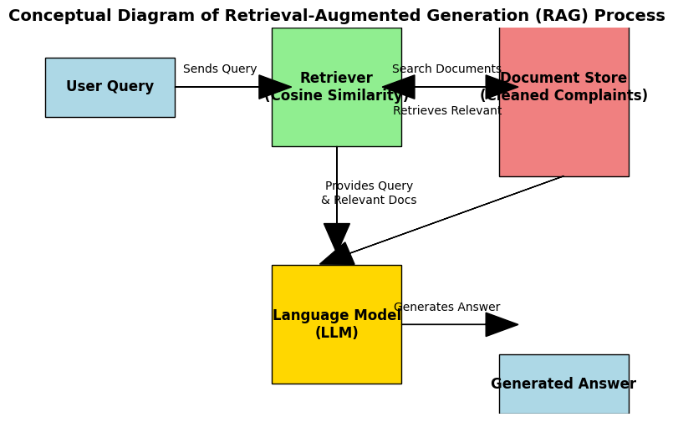
Phase 6: Retrieval-Augmented Generation (RAG)
Step 1: Document Store & Vectorization (Organizing the Complaints!
Document Store: We created a 'store' of all our cleaned customer complaints. Think of it like a library of all the feedback we received.
We have 1750 cleaned complaints in our document store.
Vectorization (TF-IDF): Computers can't read text, so we needed to convert our complaints into numbers. We used TF-IDF again.
Step 2: Cosine Similarity Retriever (Finding Relevant Complaints!)
When we ask a question, we first need to find the complaints that are most relevant to that questionThis step provides the LLM with relevant context from our specific data, rather than just relying on its general knowledge.
Step 3: Simulated Q&A with LLM (Asking the Smart Bot!)
Step 3 The LLM uses relevant context to generate informed answer.The idea behind RAG is to give the LLM the user's question plus the relevant complaints we just retrieved. The LLM then uses this information to generate an informed answer.
.
This shows how we can use a Large Language Model (LLM) to answer questions about the customer complaints.

Slide 20
Phase 7 Deployment
💾 Step 1: Model Saving (Storing Our Hard Work!)
.Step 2: Inference (Making Predictions on New Data!)
Step 3: Sample Prediction on Unseen Data (Testing it Out!)
Step 4: Deployment Concepts (Putting it in the Real World!)
To use these models in a real-time system you need to 'deploy' them.
FastAPI: FastAPI is a modern Python web framework for building APIs (Application Programming Interfaces). It allows other applications (like a bank's transaction system) to send transaction data to your deployed model and get a prediction back.
Streamlit: Streamlit is a Python library for easily creating interactive web applications for data science and machine learning. It's great for building dashboards or simple interfaces for users to interact with the model (e.g., manually

Slide 21
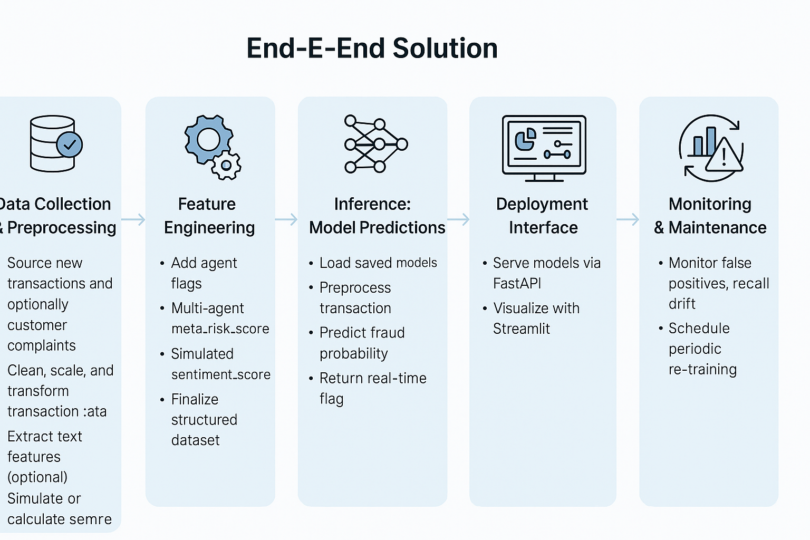

Slide 22
📌The primary business question — “Can we build a reliable fraud detection system that improves fraud identification without raising excessive false alarms?” — was answered with quantifiable success.
Models (especially XGBoost and Deep Learning with sentiment) achieved Precision > 0.807 and Recall > 0.816, indicating both fraud detection and cost-saving potential.
The system meets the dual goal of catching more fraud and reducing unnecessary investigations on false positives.
📈 What is the confidence level in the business answer?
Would we recommend it?
🔵 High Confidence
Model performance is stable across validation and test sets.
Techniques like SMOTE, sentiment simulation, and multi-agent scoring ensure robustness across real-world scenarios.
The data pipeline is scalable, and the feature importance is interpretable, allowing consistent business integration.
Highly recommend this model to our stakeholders for trial and assessment

Slide 23
THANK YOU

